Slide 1

CLIMATE CHANGE
The European situation and the impact on animal products prices
Laura & Roy

Slide 2



THE DATASETS
Global surface temperature changes over the years (1963 - 2022) - Kaggle
(141 Countries x 71 columns, 62 years)
1
Selling prices of animal products in Europe (from 2000 to 2022) - Eurostat
(19321 rows x 9 columns)
2
Selling prices of animal products in Europe (from 1969 to 2005) - Eurostat
(26920 rows x 9 columns)
3

Slide 3


HYPOTHESES
1
There is a significant change in global surface temperature in Europe and this change tends to be upward
2
There is no difference in temperature change across European subregions.
The increase in selling prices of animal products in Europe may also represent an indirect consequence of warmer temperatures
3
(increased production costs due to extreme weather events, water scarcity and others)

Slide 4
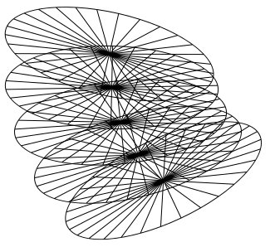
ENVIRONMENTAL POLICY PLANNING
Objective
Develop data-driven recommendations for environmental policies.
Actions
Identify countries or regions with the most significant temperature changes. Propose targeted policies to mitigate adverse effects and promote sustainable practices.

Slide 5
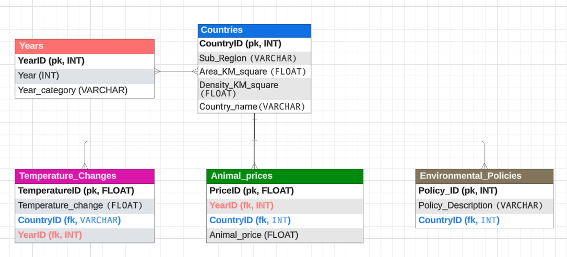
ENVIRONMENTAL POLICY PLANNING
Objective
Develop data-driven recommendations for environmental policies.

Slide 6
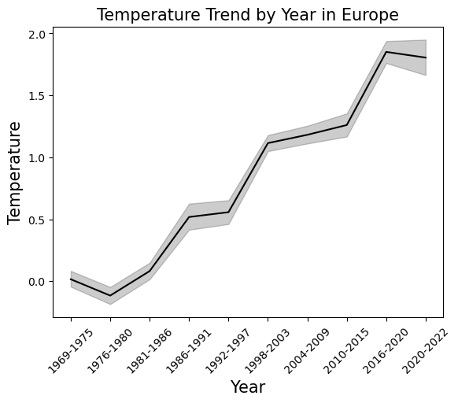
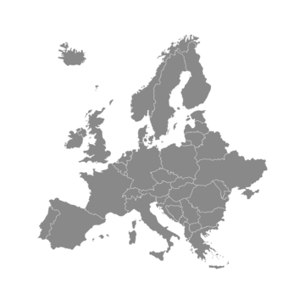
SURFACE TEMPERATURE INCREASED OVER THE YEARS

Slide 7
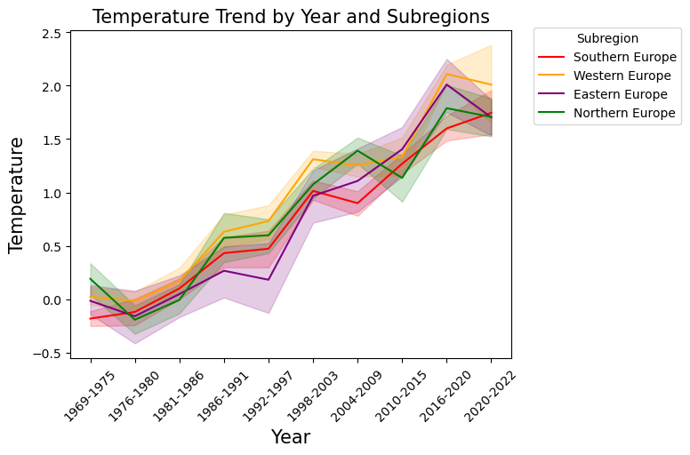
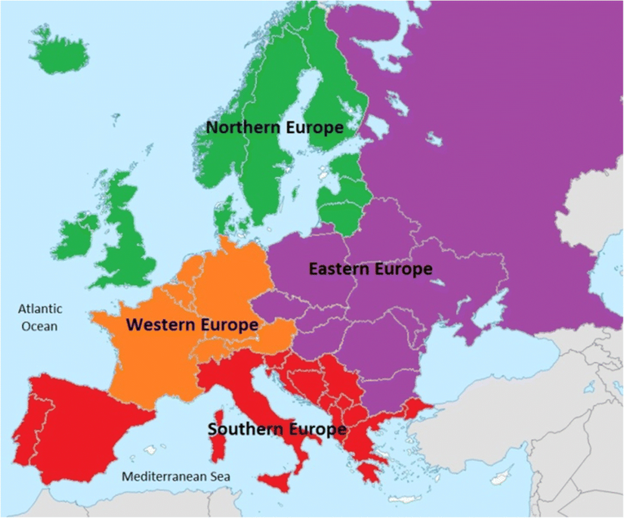
TEMPERATURE INCREASED UNIFORMLY ACROSS ALL EUROPEAN SUBREGIONS

Slide 8
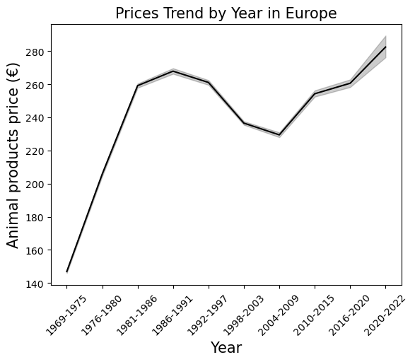

ANIMAL PRODUCTS PRICES INCREASED OVER THE YEARS IN ALL EUROPE

Slide 9
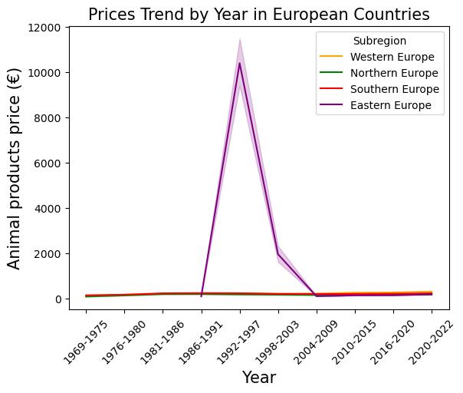
ANIMAL PRODUCTS PRICES INCREASED OVER THE YEARS IN ALL EUROPE

Slide 10

ANIMAL PRODUCTS PRICES INCREASED OVER THE YEARS IN ALL EUROPE
FALL OF THE SOVIET UNION?

Slide 11
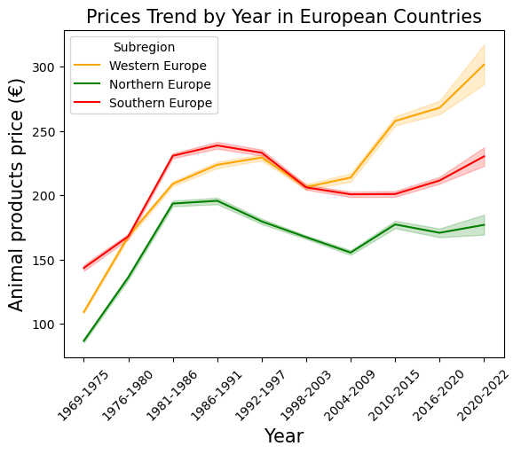
ANIMAL PRODUCTS PRICES INCREASED OVER THE YEARS PARTICULARLY IN SOUTH AND WEST

Slide 12
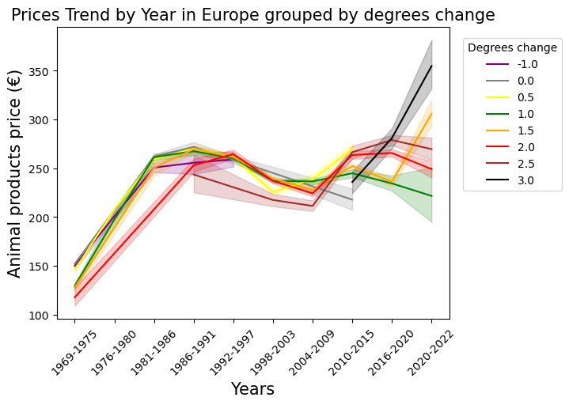
CORRELATION BETWEEN PRICES, YEARS AND TEMPERATURE

Slide 13
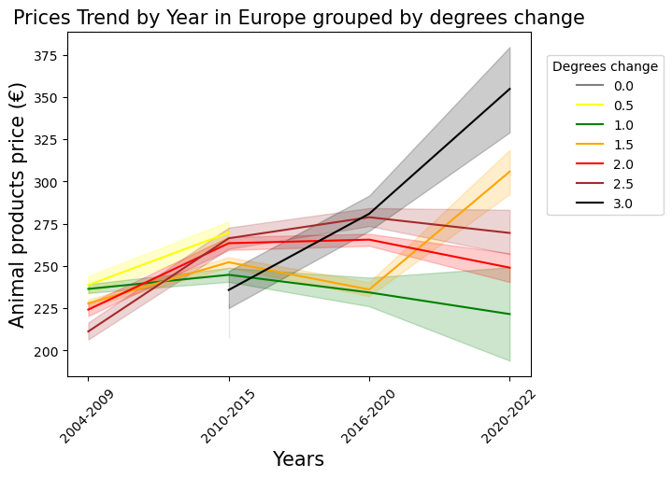
CORRELATION BETWEEN PRICES, YEARS AND TEMPERATURE

Slide 14


CONCLUSIONS (1)
The data analyses indicate a consistent upward trend in temperature across Europe and its subregions over the years.
This suggests a widespread and ongoing warming trend that requires attention and consideration in climate planning and policy-making efforts.
Potential envirnmental policies:
RENEWABLE ENERGY PROMOTION
CARBON PRICING MECHANISMS

Slide 15
CONCLUSIONS (2)
The data analyses indicate a consistent increase of animal product selling prices over the years.
Altought animal product prices can be influenced by various factors, global warming may have an impact on agricultural production, affecting crop yields and livestock productivity, thereby influencing product prices.
Potential envirnmental policies:
SUPPORT FOR SUSTAINABLE AGRICULTURE
IMPROVING THE EFFICIENCY OF ANIMAL AGRICULTURE
REDUCING ITS ENVIRONMENTAL FOOTPRINT

Slide 16

OBSTACLES
Very big databases of animal product prices
Different years countries names in the three databases
categorize years ranges and focus on subregions
Not enough time to do a proper correlation between linear regression fit-lines (prices vs temperature)
A lot of time to make the three databases consistent and to be able to merge them and proceed with the analysis
A lot of time to populate the SQL scripts and bad internet connection :(

Slide 17


THANK YOU!

